Slide 1
Young Bengal
SEMESTER-V(HONS.)
DSE-II
TAPASI MAITRA

Slide 2
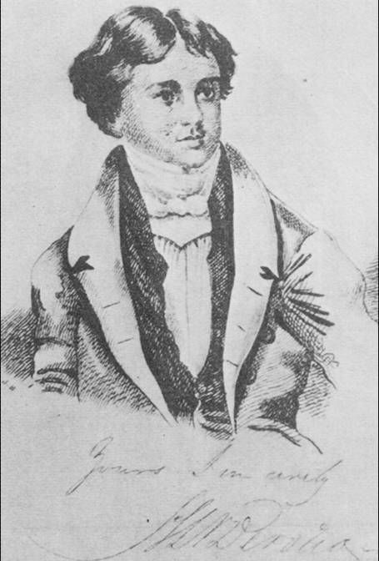
Henry Louis Vivian Derozio
Founder

Slide 3
The Young Bengal was a group of Bengali free thinkers emerging from Hindu College, Calcutta.
They were also known as Derozians, after their firebrand teacher at Hindu College, Henry Louis Vivian Derozio.

Slide 4
Derozians
Dakshinaranjan Mukherjee
Hara Chandra Ghosh
Krishna Mohan Banerjee
Peary Chand Mitra
Radhanath Sikdar
Ramgopal Ghosh
Ramtanu Lahiri
Rasik Krishna Mallick
Sib Chandra Deb

Slide 5
The Young Bengal Movement peripherally included Christians such as Reverend Alexander Duff (1809–1878), who founded the General Assembly's Institution, and his students like Lal Behari Dey (1824–1892), who went on to renounce Hinduism.
Latter-day inheritors of the legacy of the Young Bengal Movement include scholars like Brajendra Nath Seal (1864–1938), who went on to be one of the leading theologians and thinkers of the Brahmo Samaj.

Slide 6
The Derozians however failed to have a long term impact. Derozio was removed from the Hindu college in 1831 because of radicalism.
The main reason for their limited success was social conditions prevailing at that time which were not ripe for adoption of radical ideas. Further, they did not link masses through peasant causes.

Slide 7
Young Bengal followed classical economics and was composed of free traders who took inspiration from Jeremy Bentham, Adam Smith, and David Ricardo
Derozio and the Young Bengal group set two establishments and published journals that played a role in the Bengal Renaissance.

Slide 8
Academic Association
Derozio joined Hindu College in 1826 and within a short period attracted students. The Academic Association was established in 1828 under the guidance of Derozio and settled down in Maniktala. Derozio was its president.
One of his students, Uma Charan Basu, was its secretary. The principal speakers in the association were: Rasik Krishna Mallick, Krishna Mohan Banerjee, Ramgopal Ghosh, Radhanath Sikdar, Dakshinaranjan Mukherjee, and Hara Chandra Ghosh. Amongst its organisers were Ramtanu Lahiri, Sib Chandra Deb and Peary Chand Mitra.

Slide 9
Prominent members
Krishna Mohan Banerjee (1813–1885)
Tarachand Chakraborti (1805–1855)
Sib Chandra Deb (1811–1890)
Hara Chandra Ghosh (1808–1868)
Ramgopal Ghosh (1815–1868
Ramtanu Lahiri (1813–1898)
Rasik Krishna Mallick (1810–1858)
Peary Chand Mitra (1814–1883)
Dakshinaranjan Mukherjee (1818–1887)
Radhanath Sikdar (1813–1870)

